Slide 1
Hepatitis A:
Highly contagious but not fatal
Transmission | Fecal-Oral Route Contaminated water Only acute < 6 months (Does not become chronic)
Pathophysiology | HAV RNA is ingested → Replicates in hepatocyte Release into billary system (stable b/c no lipid envelope) → elim feces
Diagnosis | Difficult to diagnose b/c usually asymptomatic Anti-HAV: Antibody to HAV
Prophylaxis:
Cleanliness | Wash hands, Don’t get uncooked meat
Vaccines | Hep A vaccine as child (in Immunization notes) Havrix, Vaqta
Tx | No chronic liver disease with Hep A and not fatal
None | No tx b/c it is a self limiting disease
Notes:
HAV has no lipid envelope and is stable when excreted from the infected liver to the bile to enter the gastrointestinal tract. It has been found to survive in experimentally contaminated fresh water, seawater, wastewater, soils, marine sediment, live oysters, and creme-filled cookies.

Slide 2
Hep B: General
Transmitted | Body Fluids: Blood, Semen (sex)
Patho (next slide) | HBV is not directly cytopathic; instead it is thought that the immune response to the virus is cytotoxic to hepatocytes.
% Acute Infection | 2%
% Chronic hep b (CHB) | 15% will develop chronic Hep B
Anti-HB | Is Lifelong
Notes:
85% will fix themselves
15% will develop chronic hep B

Slide 3
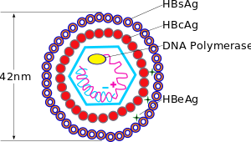
Hep B Pathophysiology
1. HBV + strand DNA enters
2. Forms cccDNA
3. Produces RNA
4a. RNA → protein:
HbsAg, HbcAg, HbeAg
4b. RNA → - DNA
5. - DNA → + DNA
6. Replicates and exits cell
HBV is not directly cytopathic; instead it is thought that the immune response to the virus is cytotoxic to hepatocytes.
Notes:
covalently closed circular DNA

Slide 4
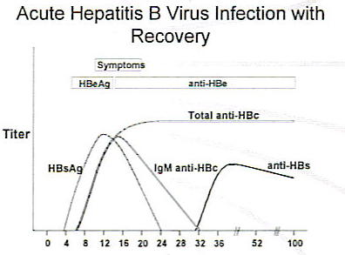
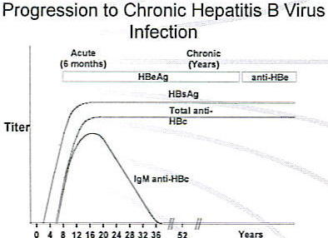
Hep B Diagnosis
 | Antigen | Antibody
HB surface (Hbe) | 1st marker of infection because on surface | Tx Or Vaccinated
HB e | High level of virus Not much HBe. If detect, then it’s a problem | seroconversion
HB core (HBc) | Not detectable b/c in nucleus | Tx only NOT vaccinated b/c in nucleus

Slide 5
Hep B Tx
Notes:
Alkaline phosphatase 25 – 100
alanine aminotransferase (ALT)
Male: 10 – 40 units/L
female: 7 – 35 units/L

Slide 6
Hep B: Prophylaxis, Tx and monitoring
Prophylaxis | MOA | Drug | Who
Hep B Vaccine | Containing HBsAg | Recombivax HV Energix-B | All children in US Pts with CKD Healthcare workers
Tx | Drug | Duration
Notes | First line: Entecavir/Tonofovir Search for: Hep B Tx.doc | Indefinite
Monitor | When
HbeAg, HbsAg and HBV DNA | At Start of therapy then q6 months for 1 year then qyear

Slide 7
Comparison of Agents
Agents | Dose | Side Effects | Potency | Resistance
Interferon (SQ) | Weekly CBC for 1st 2 wk then monthly | Flu-like, fever, myalgia, ↓ WBC | Not recommended in decompensated ONLY for 1 yr TX | None
1st LINE
Entecavir | 0.5 mg PO daily | GI upset | HIGH | Low
Tenofovir | 300 mg PO daily Renal adjustment | GI upset | HIGH Can replace Adefovir | Unknown
2nd LINE
Adefovir | 10 mg PO daily | Nephrotoxicity Lactic acidosis | Least potent Slowest to suppress HBV | None @ 1 yr 30% @ 3 yrs
Telbivudine | 600 mg PO daily | Myopathy Peri neuropathy | HIGH | High
3rd LINE
Lamivudine | 100 mg PO daily | N/V, HA Fatigue | Moderate | High

Slide 8

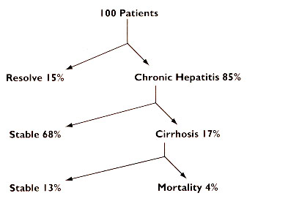
Hep C (HCV):
Transmission | Blood
Progression | Week 2-4 is crucial in determining Genotype Can take 20 – 40 years to cirrhosis Treated when HCV RNA is undetectable 6 months after Tx
Epidemiology | Most Common Worldwide HCV → Cirrhosis → Transplants
Virology | 6 Genotypes Genotype 1 is most resistant (relevant in Tx)

Slide 9
Definition of Responses
Tx initiated
4 wks
12 wks
24 wks
Undetectable (RVR)
Undetectable (Complete EVR)
≥ 2-log ↓
(Partial EVR)
Detectable (Partial Responders)
< 2-log ↓
(NON Responders)
End of Tx
24 wks
Undetectable
(ETR)
Undetectable
(SVR)
Undetectable
(ETR)
Detectable
(Relapsers)

Slide 10
Definition of Response:
Rapid viral response (RVR) | patient with undetectable viral load at week 4 of treatment
Early virologic response (EVR) | patient who experiences at least a 2-log reduction in viral load by the 12th week of treatment (partial EVR) or a patient with undetectable viral load by the 12th week of treatment (complete EVR)
End of treatment response (ETR) | patient with no detectable viral load at the
 | end of treatment
Sustained virologic response (SVR) | patient with no detectable viral load at the conclusion of therapy and 24 weeks (6 months) later
Non-responders | patient with less than a 2-log reduction in viral load after 12 weeks
Partial responder | patient with at least a 2-log reduction in viral load but detectable viral levels after 24 weeks of therapy
Relapsers | patient who responds to therapy but whose viral load becomes detectable once therapy has been discontinued

Slide 11
Pathophysiology

Slide 12
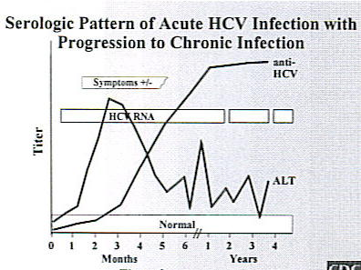
HCV Clinical Course | Usually asymptomatic When acute infection occurs, ALT can be 15x ULN of 50 U/L
In chronic infection: HCV RNA is always present

Slide 13
HCV Treatment
Screening prior to treatment:
Cardiac evaluation
AFP (alfa fetal protein to rule out HCC, cancer)
Thyroid function tests.
Check Genotype
Genotype 1
Genotype 2-6
3 Drug Tx b/c Resistance
2 Drug Tx
PEG-IFN
+
Ribavirin
+
Telaprevir or Boceprevir
PEG-IFN
+
Ribavirin
Notes:
Teleprevir and Boceprevir: NS3/4A protease inhibitors

Slide 14
PEG-IFN
Drugs: Pegintron and Pegasys
 | Peg-IFN α2b | Peg-IFN α2a
Brand | Pegitron | Pegasys
Dosing | SQ Weekly | Weekly
Storage | Room Temp | Refrigerated
Contraindications | Decompensated Liver Disease (liver & body) Total Bilirubin > 1.5 INR > 1.7 Ascites Hepatic Encephalopathy | Same as α2b
Side Effects | Flu Like Syndrome, tx NSAIDS/APAP Neutropenia, GSCF as prophylaxis Thrombocytopenia CNS such as depression, anxiety | Same as α2b
Notes:
MOA: They induce interferon-stimulated genes (ISGs) that help establish an antiviral state within cells, though the response is not virus-specific. Alpha interferons act by binding to cell surface receptors, activating a response cascade that culminates in the expression of multiple ISGs, some of which block viral protein synthesis. In addition, alpha interferon may lead to a decrease in viral RNA stabilit

Slide 15
Ribavirin
Drug | Ribavirin
Brand | Copegus (tablet) Rebetol (capsule)
Class | Nucleoside analog (DNA) MOA: inhibits/ depletes intracellular guanosine triphosphate
Contraindications | Pregnancy X Renal Adjustments
Side Effects | Hemolytic Anemia All pts require cardiovascular workup prior to initiation therapy

Slide 16
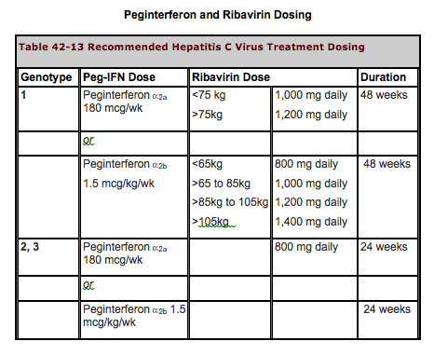
PEG-IFN + Ribavirin

Slide 17
NS3/4A protease inhibitor : Use only in combo
 | Boceprevir | Telaprevir
MOA | Inhibit post-translational process | “ “
Brand | Victrelis | Incivek
Dosing | 800 mg PO TID with food | 750 mg PO TID with food Food = 20 g fat
Adverse Effects | Anemia → reduce dose Neutropenia → GCSF Thrombocytopenia Dysgeusia → take with milk | Rash → antihistamines, steroids Anemia Anal itching → eat fiber, loperimide
Futility Rule When to stop Tx | Week 4 HCV RNA > 1000 6 months HCV RNA still detectable | “ “
Drug Class | Contraindication
Anticonvulsants | Carbamazepine, Phenobarbital, phenytoin
Antimycobacterials | Rifampin
Ergot derivatives | Dihydroergotamine, methylergonovine
Gi motility agents | Cisapride
HMG CoA reductase inhibitors | Lovastatin, simvastatin, atorvastatin
PDE5 inhibitor | Sildenafil, tadalafil
Sedatives | Triazolam, midazolam
Immunosuppressants | Cyclosporine, tacrolimus
Oral contraception | Ethinyl estradiol- decrease drug exposure. Two effective nonhormonal methods of contraception should be used

